Slide 1



February 4th, 2025
Quantifying Context: Analytical Models of Consumer Choice
Exploring Models from “50 Years of Context Effects”
Journal of Consumer Research
Journal of Marketing Research
Attention Trajectories Capture Utility Accumulation and Predict Brand Choice
Course
Data 735
Contributor
Delroy Nichols

Slide 2

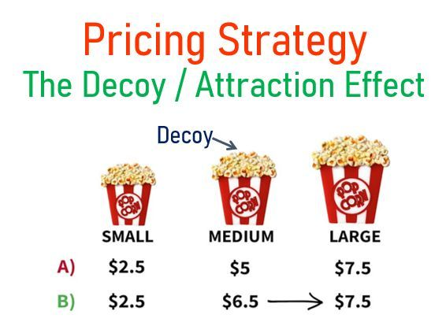
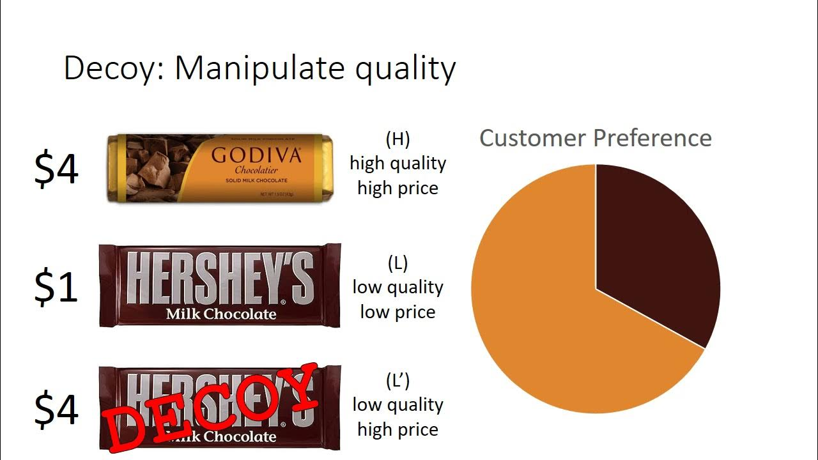
Why Context Matters
The Importance of Context
Consumer choices are not made in isolation.
The available options (the “context”) heavily influence preference.
This effect is not limited to consumer behavior, it influences choices across social sciences and other disciplines.
Delroy Nichols

Slide 3
Consumer Preferences
Consumer Analysis
Similarity Effect: The introduction of a new alternative disproportionately reduces the probability of choosing a similar alternative.
Compromise Effect (Extremeness Aversion): Adding an extreme option makes an intermediate option more attractive.
Attraction Effect
Similarity Effect
Single-Option Aversion
Attraction Effect (Asymmetric Dominance): Adding a decoy option that is asymmetrically dominated by a target option increases the choice share of the target.
Single-Option Aversion: The same option may be chosen more frequently when competing options are present than when it is the sole option.
Compromise Effect
Phantom Effect
Delroy Nichols

Slide 4

Two Paths, One Goal: Understanding Context Effects
Two Approaches to Context Effects
QUANTITATIVE
BEHAVIORAL
Behavioral Research
Quantitative Modeling
Theories in behavioral research often emphasize how consumers use reasons or justifications to make choices, or how emotions influence their decisions.
Behavioral Research Limitations:
Lack of formal mathematical models that limit the ability to make market share predictions.
Disjointed theoretical accounts with no unifying explanation of context effects.
Utility-maximization models propose that people make pairwise comparisons between the attributes of choice options, with disadvantageous comparisons having a larger impact. These models calculate context-dependent utilities and select the option with the highest utility
Computational cognitive models describe how decision-makers acquire and integrate information over the time course of the decision process. These models often involve an accumulation-to-threshold process, in which preferences for options evolve dynamically until a threshold is reached, at which point an option is selected..
Delroy Nichols

Slide 5


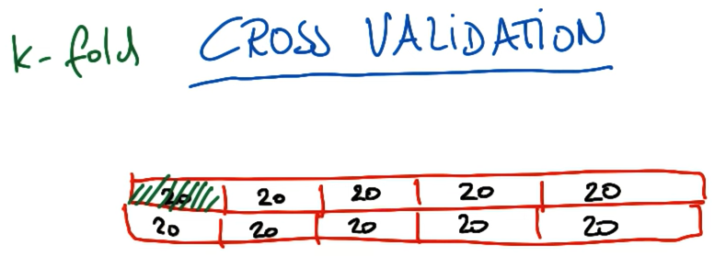


Bridging the Gap
K-Fold Cross Validaiton
The advantages of K-fold cross validation is that if you have a limited amount of data to train your model but still want to to have increased accuracy to predict outcomes. This can help with that.
Disadvantages are the time it takes to complete training and the time the model takes to run.
Delroy Nichols

Slide 6
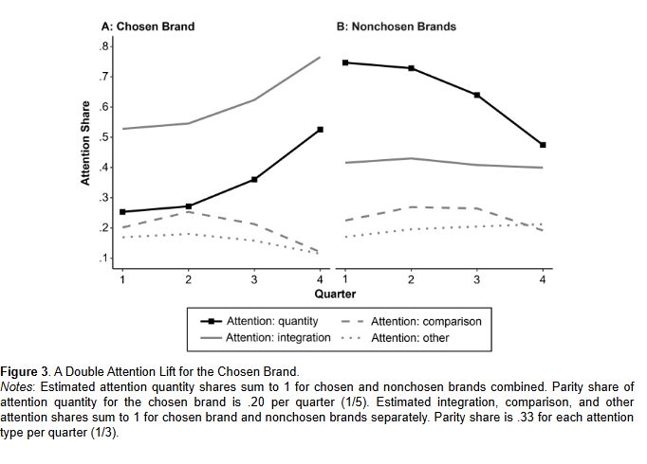
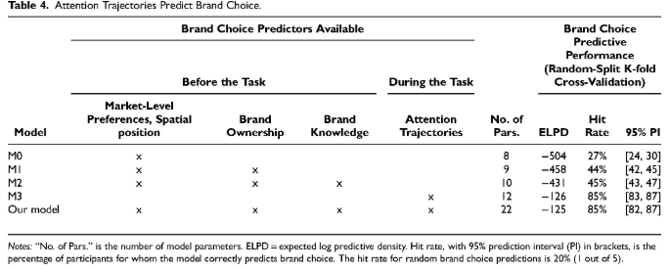
Roadmap for the Future
Future Uses
Future Uses
Future Uses
Incorporating Accumulation-to-Threshold Models into Consumer Research: Exploring how consumers establish and use thresholds in decision-making, whether they are fixed, and if thresholds vary across options and choice sets.
Integrating Behavioral Insights into Quantitative Models: Developing models that incorporate factors such as reasons for choice, emotional responses to decision conflict, and inferences about ideal attribute values, potentially using decision model parameters to modulate the impact of these variables.
Studying Attention and Memory: Insights from attention trajectory data can inform advertising placement, website design, and in-store display strategies.
Delroy Nichols
Market Analysis

